Slide 1
Smart study planner
CAPSTONE PROJECT
Presented By:
Student Name : Manish J
College Name : Seshadripuram Degree College
Department : BCA
AICTE Student ID : STU67cbcb98101661741409176
Internship ID : INTERNSHIP_17522267216870dba1e54a83

Slide 2
OUTLINE
Problem Statement (Should not include solution)
System Development Approach (Technology Used)
Algorithm & Deployment (Step by Step Procedure)
Result
Conclusion
Future Scope(Optional)
References

Slide 3
Problem Statement
The Smart Study Planner is a lightweight web application designed to help students:
Create, view, and manage study tasks/goals.
Set deadlines using date and time inputs.
Track progress by marking tasks as completed.
View upcoming tasks in a visual timeline.
Store tasks locally in the browser (using Local Storage) so that data is not lost after refreshing or closing the page.
By combining simplicity with functionality, this planner aims to boost productivity, enhance time management, and reduce stress, making academic planning more effective and accessible.

Slide 4
System Approach
Frontend Technologies:
HTML5 – Structure of the webpage
CSS3 – Styling and responsive layouts
JavaScript – Dynamic interactivity (cart, filtering, total calculation)
Design Approach:
Clean and user-friendly interface
Mobile-responsive design
Modular separation of HTML, CSS, and JS files

Slide 5
Algorithm & Deployment
Product Catalog Creation
Define product categories and details (image, price, description).
Frontend Design
Layout using HTML and CSS (grid & cards).
Interactive Features
Add-to-Cart, Remove-from-Cart functions in JavaScript.
Real-time total price calculation.
Product filtering by category.
Modal views for product details.
Testing
Cross-browser compatibility
Mobile responsiveness
Deployment
Host using GitHub Pages / Netlify for free and easy access.

Slide 6
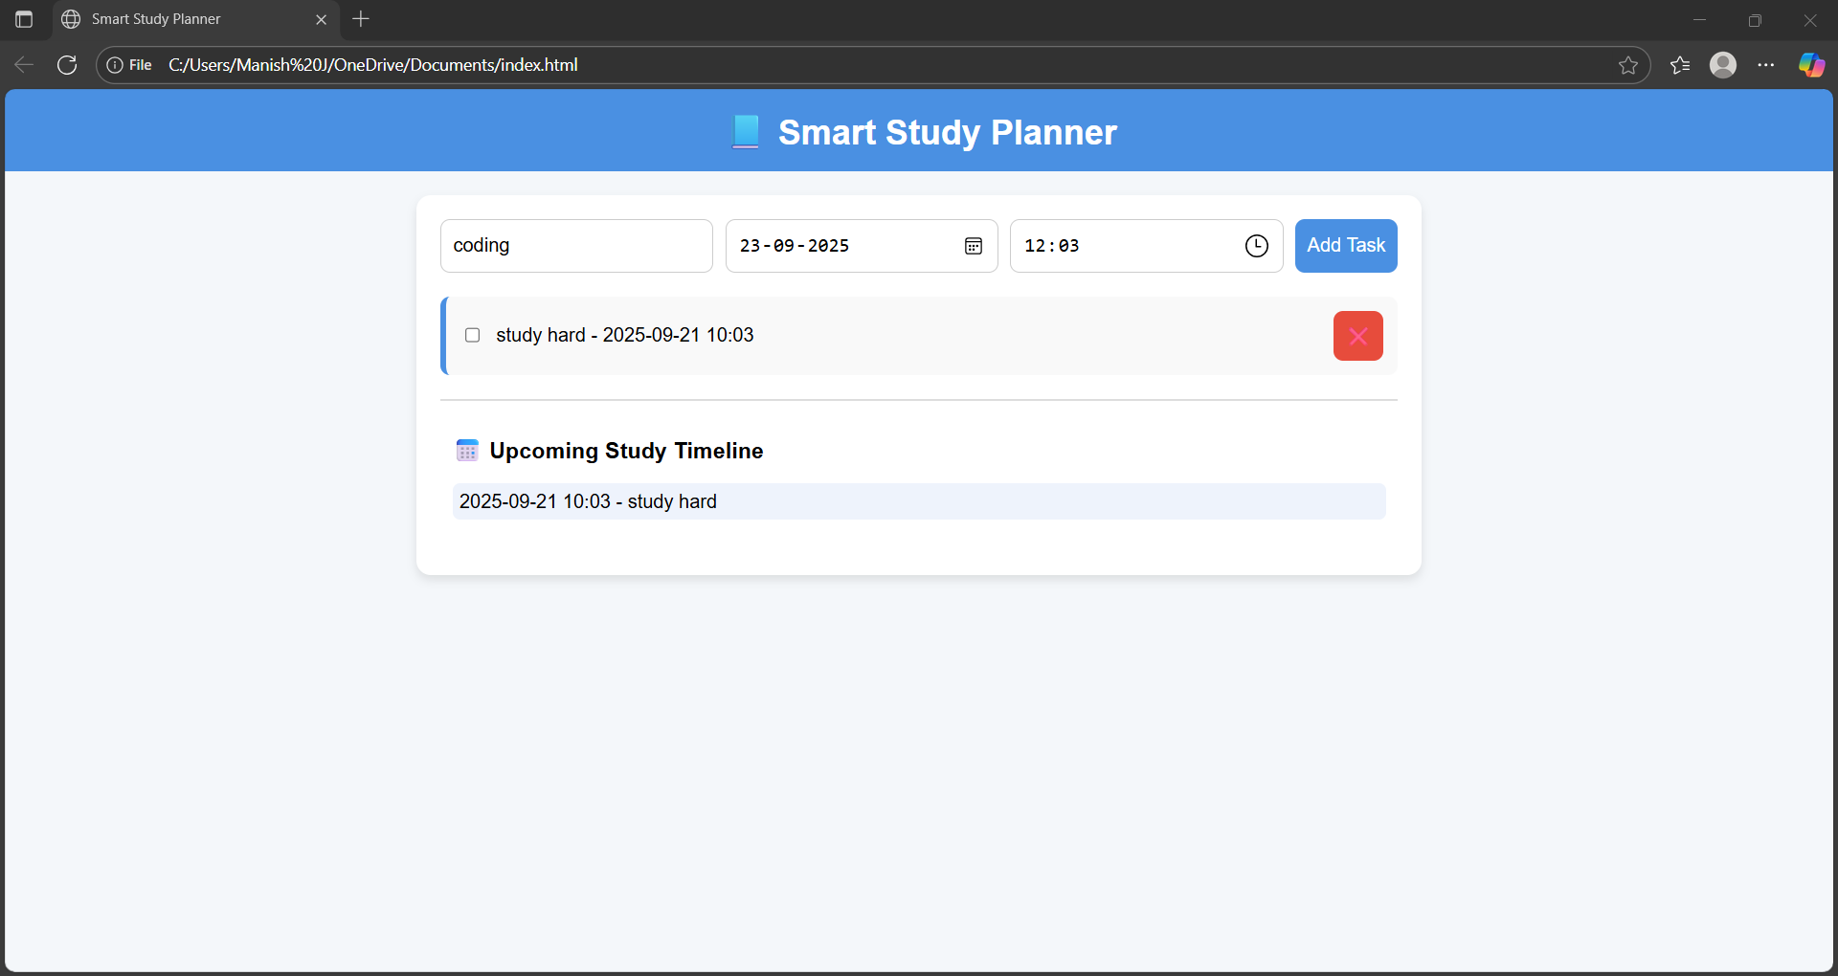
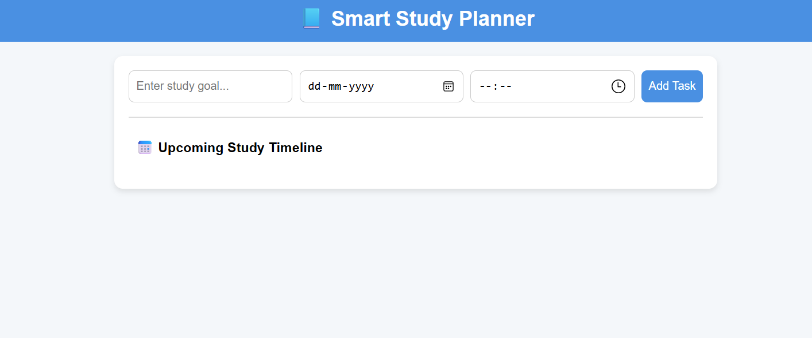
Result
Attach your Github link
https://github.com/manishjmanish2005/Smart-Study-Planner.git

Slide 7
Conclusion
The Smart Study Planner successfully addresses the challenges students face in managing their academic tasks and deadlines. By integrating features such as task creation, completion tracking, reminders with date & time, and a visual timeline, the system provides an organized and user-friendly way to plan studies.
The use of Local Storage ensures that progress and goals are preserved even after closing or refreshing the browser, making it reliable without the need for external databases. Overall, this project enhances time management, productivity, and self-discipline among students, offering a simple yet effective digital solution for academic planning.

Slide 8
Future scope(Optional)
While the Smart Study Planner provides a strong foundation for organizing and tracking study goals, there are several possibilities for future enhancements to make it more powerful and user-friendly:
Cloud Storage & Multi-Device Sync
Enable users to log in and sync their study plans across devices.
Store data securely on the cloud instead of just local storage.
Smart Notifications & Reminders
Add pop-up or push notifications before task deadlines.
Send reminders via email or mobile notifications.
Progress Analytics & Visual Reports
Display completion percentage using progress bars or charts.
Provide weekly/monthly performance insights.
Calendar Integration
Sync tasks with Google Calendar or Outlook for better schedule management.
.

Slide 9
References
List and cite relevant sources, research papers, and articles that were instrumental in developing the proposed solution.
MyStudyLife — a student planner & study app (for organizing schedule, tasks, exams) MyStudyLife
“Learn How to Use LocalStorage in JavaScript with a Todo App” — tutorial showing how to build a to-do app and persist data using Local Storage. Medium
“Storing Todos Locally | CodeSignal Learn” — lesson explaining how to store and retrieve todo items in Local Storage so that data persists across sessions. CodeSignal
“How to Create a To-Do App with HTML, CSS and Vanilla JavaScript with Local Storage” — a tutorial on dev.to that walks through adding tasks, persisting them.

Slide 10
THANK YOU

